Slide 1
Concentrated Animal Feed Operation (CAFO) Manure Economic Analysis
Alex Badgett, Emily Newes, Anelia Milbrandt
DRAFT – DO NOT CITE/DISTRIBUTE
November 1, 2017

Slide 2
Modeling Overview

Slide 3
Objectives
Beef Manure
Dairy Manure
Swine Manure
Identify the economic drivers of manure management of CAFOs
Understand the costs (transport, land application) and values (nutrients) farms assign to manure, and the drivers of each
Model manure production and economics across the country to identify areas of interest for waste-to-energy (WTE)
DRAFT – DO NOT CITE/DISTRIBUTE

Slide 4
Evaluating Supply & Demand
Supply
Demand
Point-by-point CAFO manure production from Milbrandt et al, 2017¹ (pending journal publication)
Adjusted for confinement and recoverability
Supply computed in terms of Nitrogen & Phosphorous nutrients
Estimated by nutrient demand of farmland acreage in county
Crop types from Kellogg et al, 2007² and production by county from USDA National Agricultural Statistics Service (NASS)³
² R. L. Kellogg, D. C. Moffitt, and N. R. Gollehon, “Estimates of Recoverable and Non-Recoverable Manure Nutrients Based on the Census of Agriculture,” 2007.
³ https://www.nass.usda.gov/
¹A. Milbrandt, T. Seiple, D. Heimiller, R. Skaggs, and A. Coleman, “Wet Waste-to-Energy Resource Assessment (Pending Publication).”
DRAFT – DO NOT CITE/DISTRIBUTE

Slide 5
Model Market Scenarios
Scenario 1
Manure supply is less than ag land fertilizer needs
Price assigned based on manure nutrient content
Scenario 2
Manure market exists
Price assigned based on manure nutrient content
Manure Supply/Demand Scenarios
Scenario 3
Manure supply is greater than ag land fertilizer needs
Excess manure price assigned from hauling and field application costs
DRAFT – DO NOT CITE/DISTRIBUTE

Slide 6
National Manure Supply Curve
Fertilizer/Commoditized Manure
A portion of US animal manure is modeled at a negative cost to WTE facility (Scenario 3)
Majority of manure can be utilized as an ag land fertilizer (Scenarios 1 & 2)
Excess Manure
Although excess manure is modeled at a negative cost, farmers are unlikely to pay to have manure removed unless the CAFO is required to do so by regulation.
DRAFT – DO NOT CITE/DISTRIBUTE

Slide 7
Areas of Further Analysis

Slide 8
Willingness to Accept Manure and Suitable Cropland
Farm Willingness To Accept Manure (WTAM) as a fertilizer varies, and is a driver of manure cost³ and demand
Proportion of nearby ag land that manure can be applied on varies similarly
In our model, a metric for both is averaged from these ratios by county:
Ratio of farms using manure fertilizer to total number of farms using fertilizer (USDA NASS)
Ratio of cropland receiving manure fertilizer to total cropland receiving fertilizer (USDA NASS)
Values range 0 to 1 and average 0.22
³ J. M. MacDonald, M. O. Ribaudo, M. J. Livingston, J. Beckman, and W. Huang, “Manure Use for Fertilizer and for Energy: Report to Congress,” United States Department of Agriculture, 2009.
⁴ R. L. Kellogg, D. C. Moffitt, and N. R. Gollehon, “Estimates of Recoverable and Non-Recoverable Manure Nutrients Based on the Census of Agriculture,” 2007.
DRAFT – DO NOT CITE/DISTRIBUTE

Slide 9
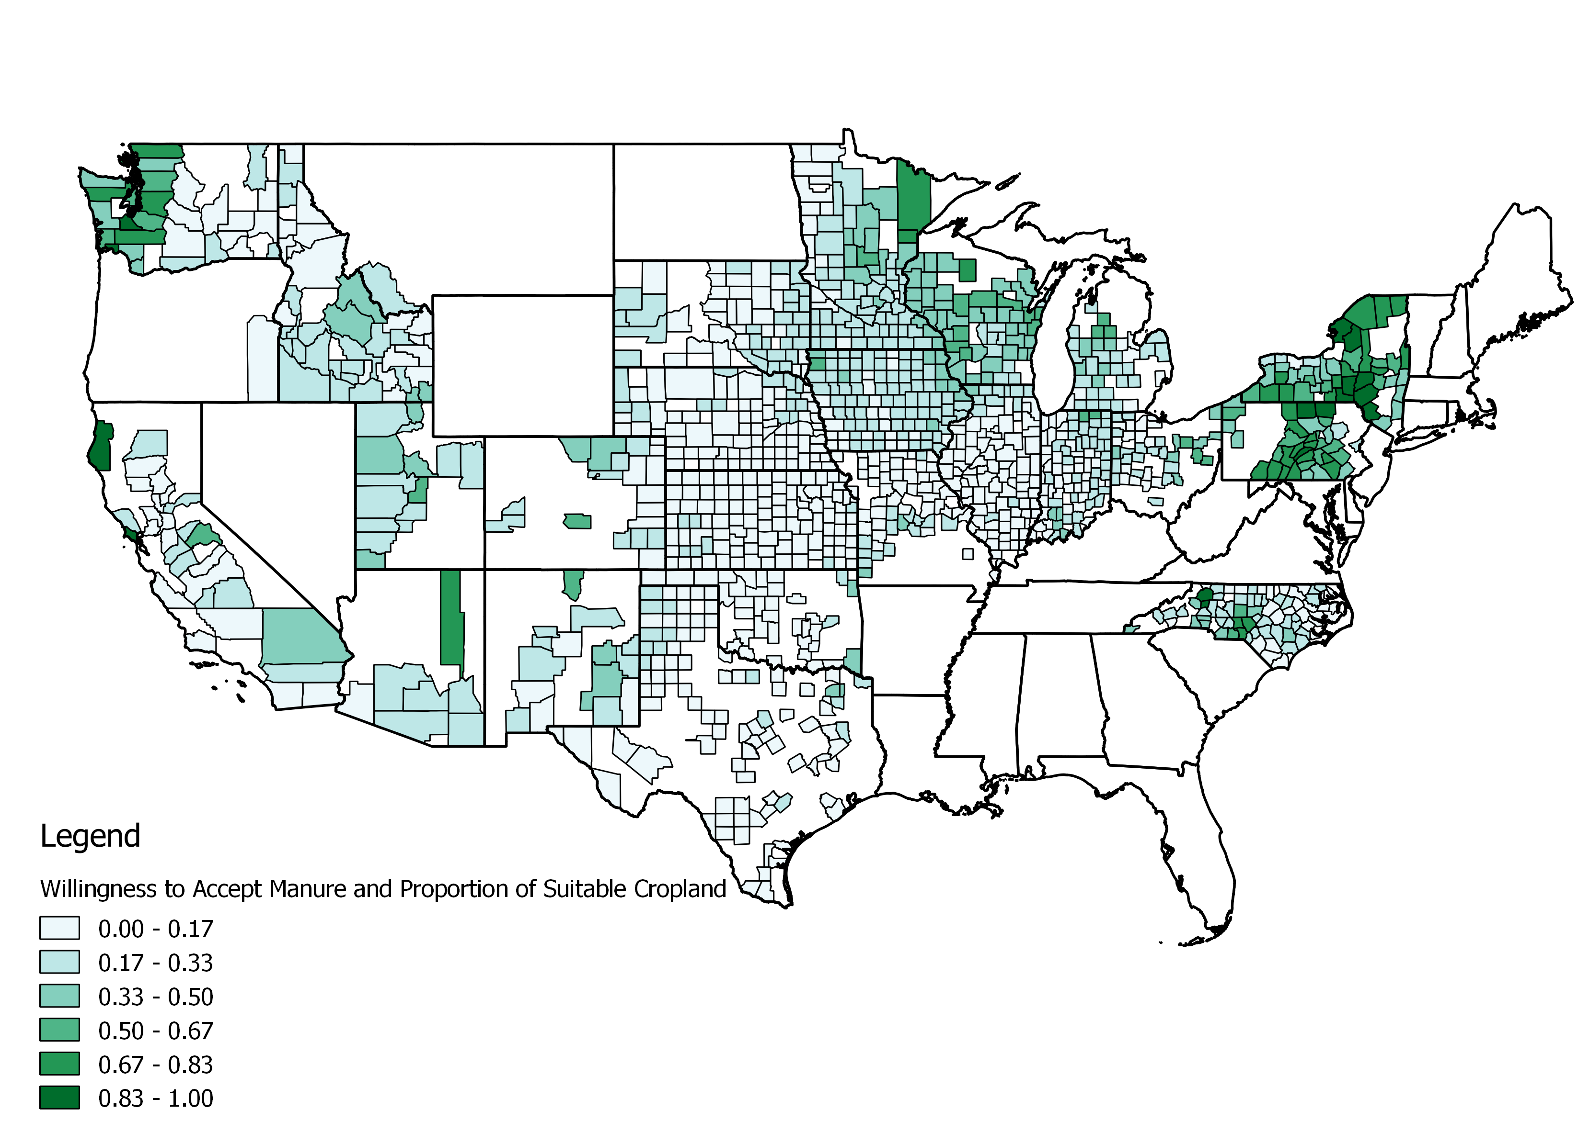
WTAM & Suitable Cropland Distribution

Slide 10
Locating Non-Poultry Manure Markets
Identified swine, dairy, and cattle manure markets from state programs and online marketplaces
Several articles discuss existence of markets, few provide specific information on market structure or manure prices
States with identified markets used in model:
Nebraska: 50% of manure is sold as fertilizer⁵
Pennsylvania: extensive manure broker program suggests functioning market⁶
⁵ K. Glewen and R. Koelsch, “Marketing Manure Part 1,” Univ. Nebraska Lincoln Biol. Syst. Eng., vol. 7, no. 5.
⁶ State of Pennsylvania, “Commercial Manure Hauler and Broker Certification Program,” 2004. [Online].
DRAFT – DO NOT CITE/DISTRIBUTE

Slide 11
Cost Determination of Manure Land Application
Costs for transport and land application of manure were modeled based on manure tonnage and regional economic parameters
Model assumes tractor and tractor drawn spreader tank with broadcast application and tillage incorporation⁷
 | $/Acre | $/Hour | $/Wet Ton | $/Gallon
Average | $29.52 | $137.28 | $19.84 | $0.08
⁷ J. C. Hadrich, T. M. Harrigan, and C. A. Wolf, “Economic Comparison of Liquid Manure Transport and Land Application,” Appl. Eng. Agric., vol. 26, no. 5, pp. 743–758, 2010.
DRAFT – DO NOT CITE/DISTRIBUTE

Slide 12
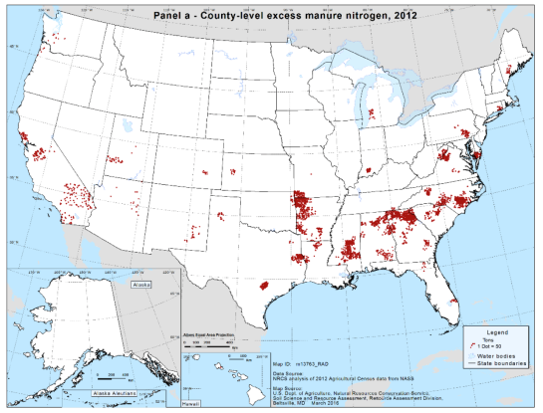
Relating USDA Modeling to WTE Model
National Resources Conservation Service considers all farms - we only consider beef, dairy, and swine CAFOs (no poultry)
⁸ N. R. Gollehon, R. L. Kellogg, and D. C. Moffitt, “Estimates of Recoverable and Non-Recoverable Manure Nutrients Based on the Census of Agriculture-2012 Results,” 2016.
DRAFT – DO NOT CITE/DISTRIBUTE

Slide 13
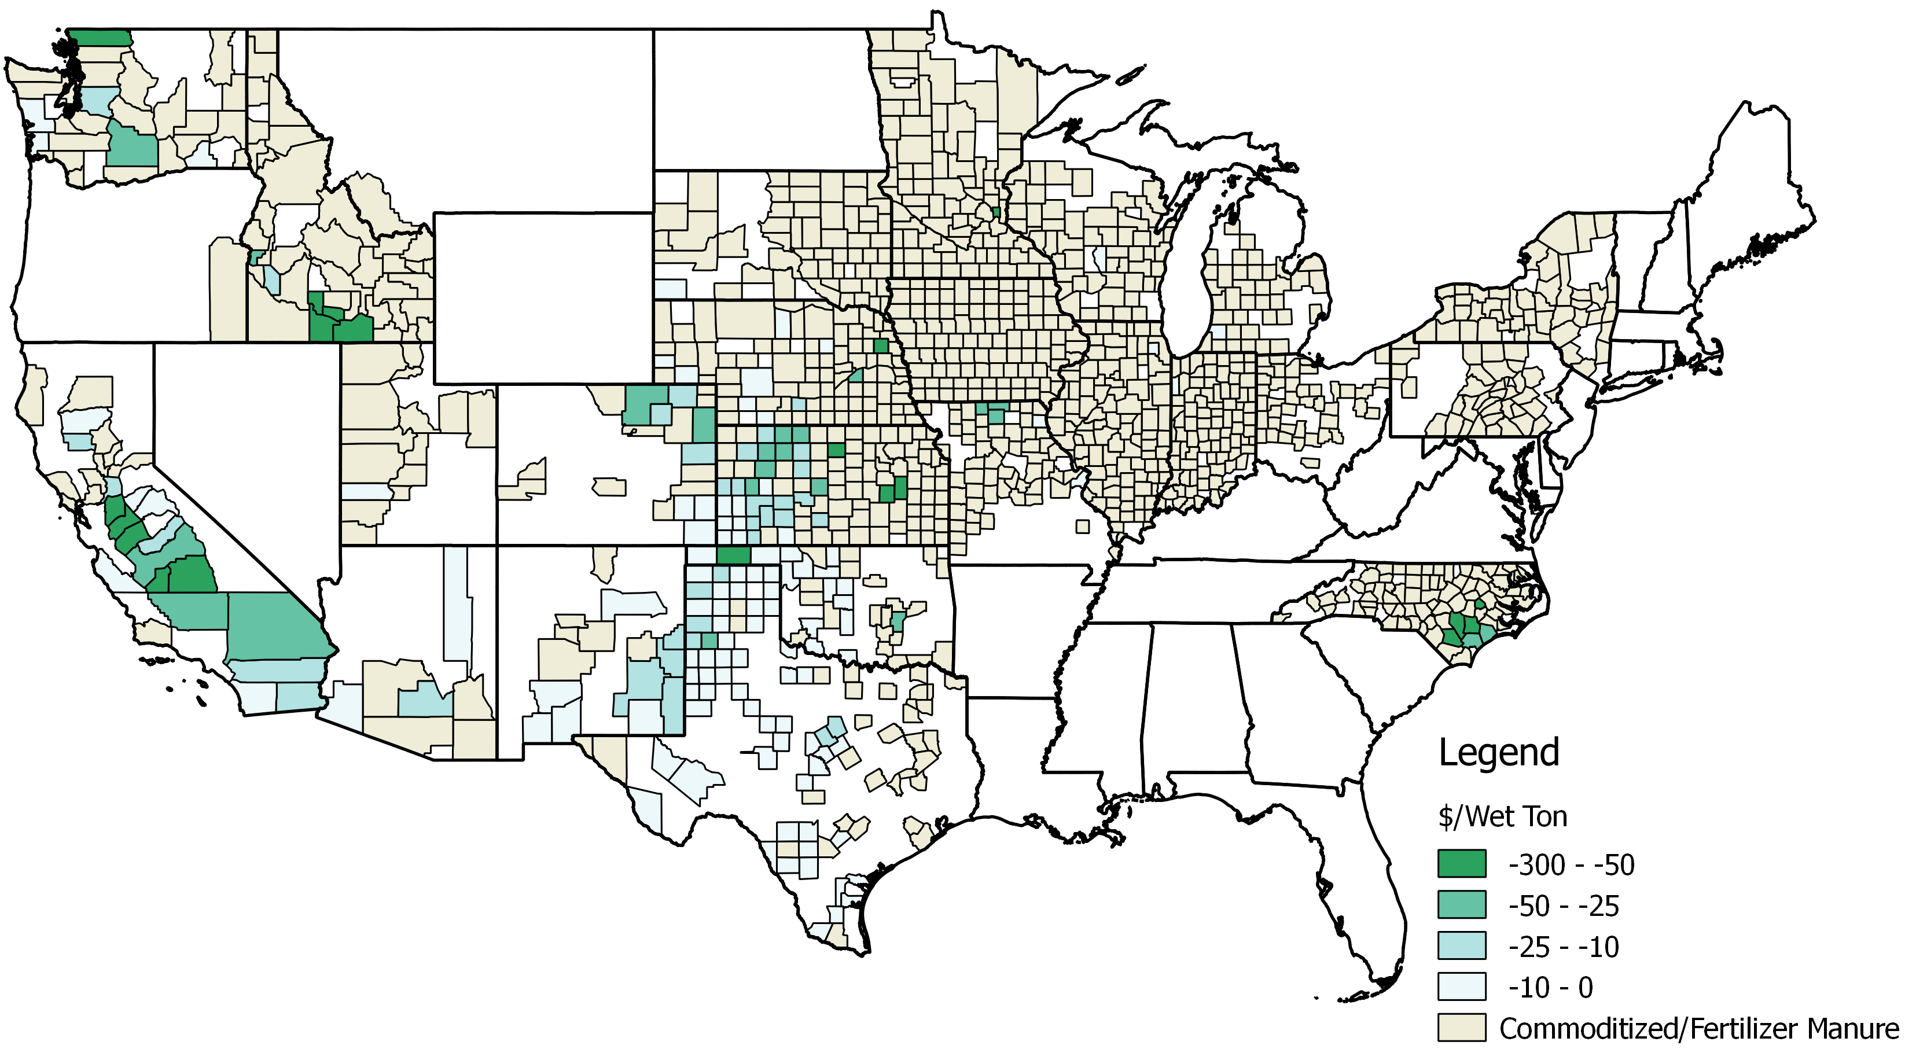
Relating USDA Modeling to WTE Model
DRAFT – DO NOT CITE/DISTRIBUTE

Slide 14
Thank you!

